Slide 1


From Light to Insight: Imaging System Prototyping for MedTech Startups
David Imrie, Ph.D., CTO, Optikos Corporation
Jorge Ferrer, Ph.D., Chief Scientific Officer, Lumicell

Slide 2
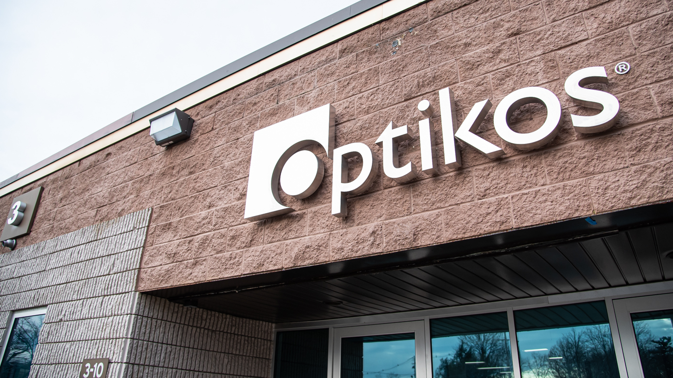
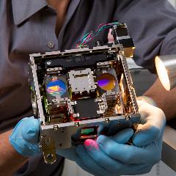

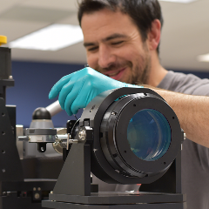
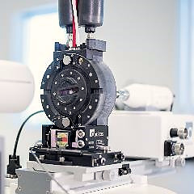
About Optikos
40+ Years in business
Located in Wakefield, MA
Hardcore optical engineering company
Products and services
ISO 9001 and ISO 13485
Product Development
Contract Manufacturing
Metrology
Products
Testing
Services

Slide 3
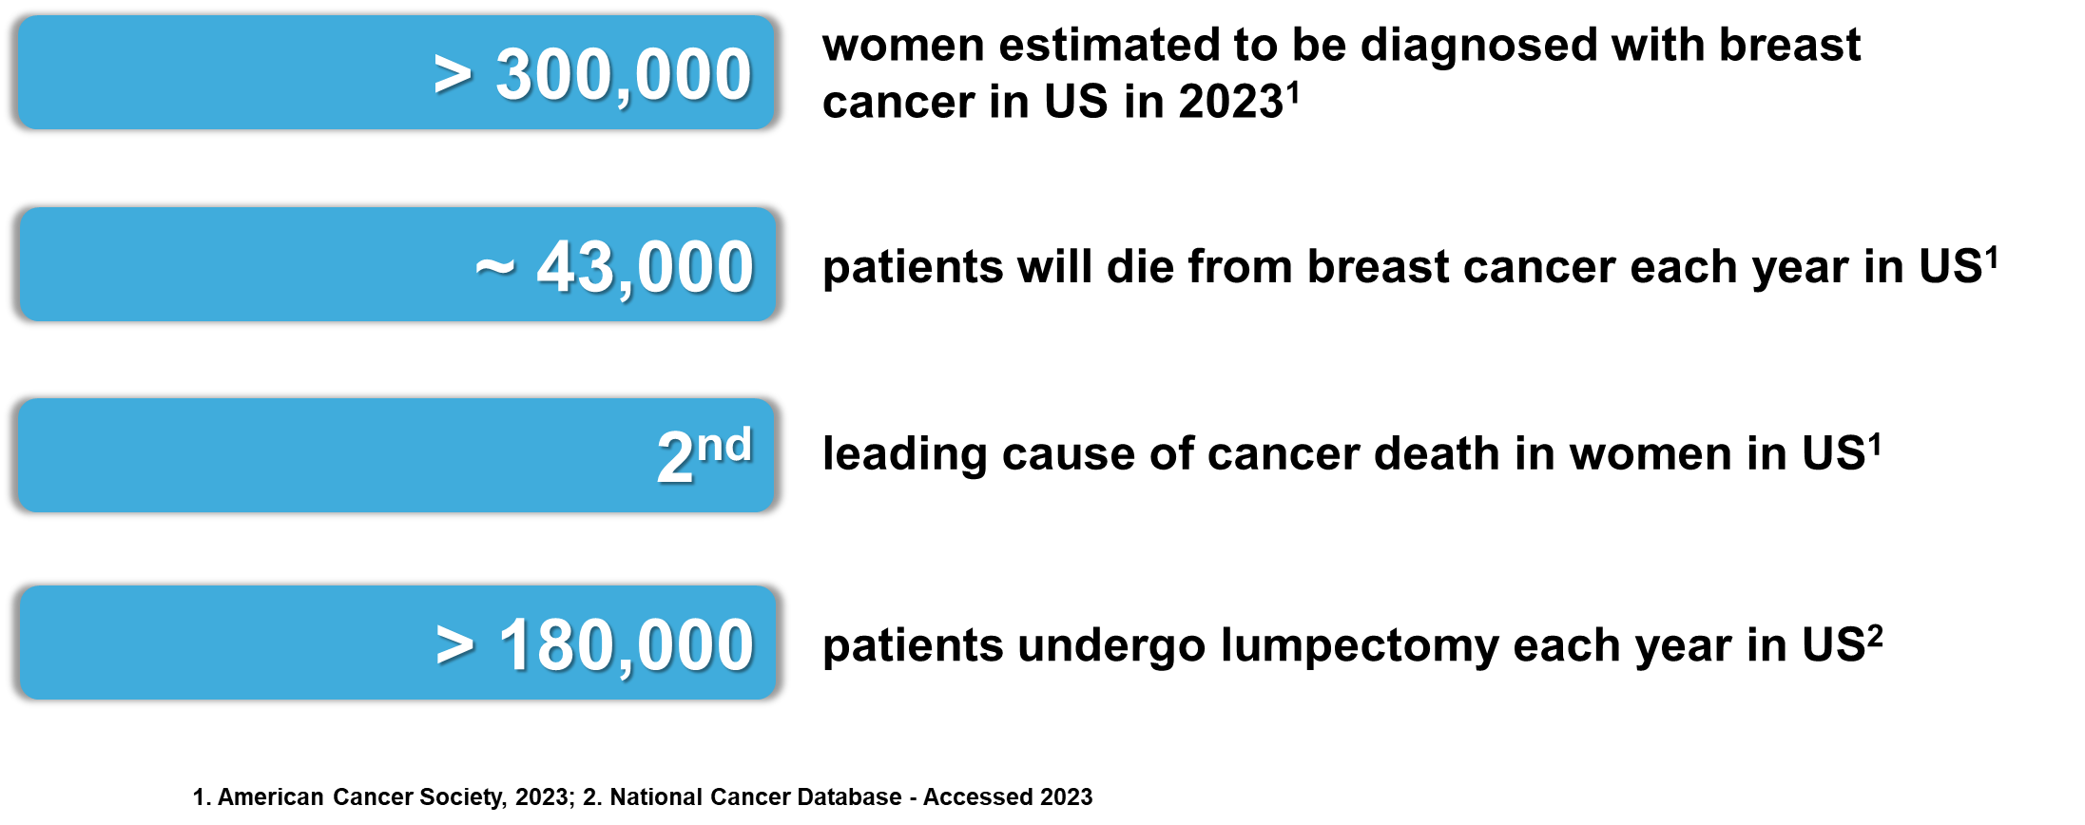
About Lumicell and Initial Target
At Lumicell, our mission is to improve the way cancer surgery is performed, starting with breast cancer.
Unmet need: Current tools limited and do not identify extent of tumor accurately enough, making it challenging to achieve complete tumor resection

Slide 4
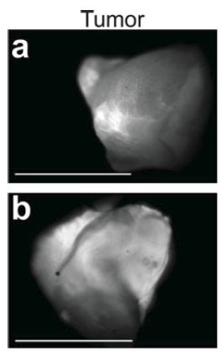
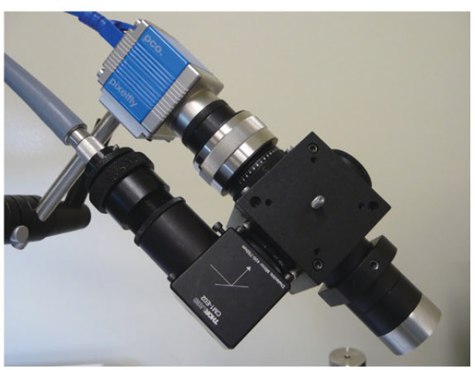
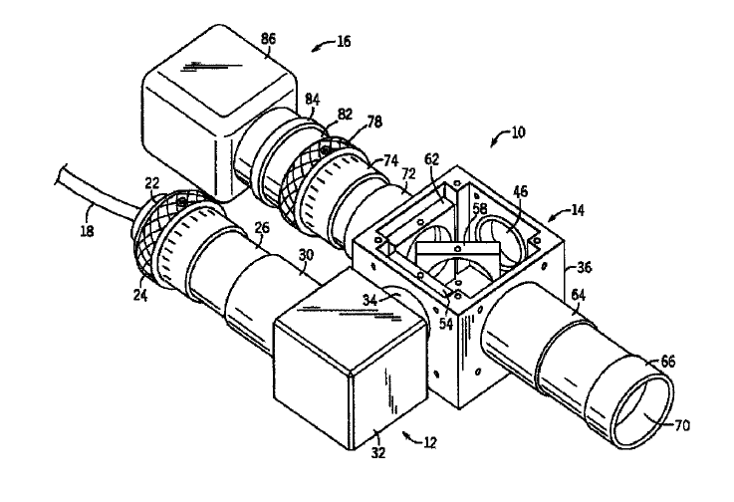
Lumicell Approach
Develop fluorescent imaging agent to target tumor and imaging device to collect its signal to direct surgeons to cancer that would be left behind
Early concept borne out of MIT: off-the-shelf components for mouse studies
Patent 8983581 (MIT)
Mito, et al., Cancer; 2012

Slide 5
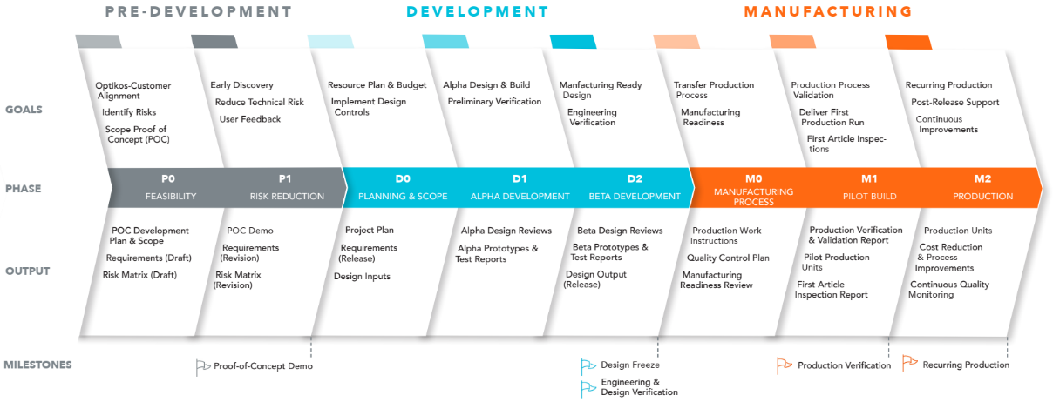
Working with Lumicell – Development of the Handheld Device
Lumicell
Optikos Engagement
Optikos & Lumicell

Slide 6
First Order Optical Design Considerations
Brief overview of some basic optical concepts

Slide 7
First Order Performance Goals
Field of view
Resolution
Depth of field
Sensitivity
Spectral considerations
How big is the area that we want to image?
What is the smallest detail we need to resolve?
Sensor size
Pixel size
Magnification
Numerical Aperture
Aberration corrections
Illumination
Filters
How far along the optical axis does the resolution need to hold up?
What is the photon budget?
What is the bandwidth and separation of the excitation and emission spectra?

Slide 8
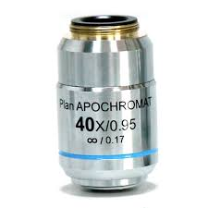



Optical Resolution Tradeoffs – Numerical Aperture (NA)
This is the sharpness of the pencil with which we’re drawing the image
Working Distance
$$NA=n\sin{θ}$$
θ
NA=0.95 (θ=72°, d=0.70µm @ 546nm)
$$d=\frac{1.22λ}{NA}$$
At the image plane, d= 40 x 0.70µm = 28µm
Higher NA → Higher Resolution

Slide 9
Why Not Just Make All Lenses High NA and High Resolution?
1.The aberrations in Ray 2 are more
difficult to correct than those in Ray 1
More Expensive!
More complicated design (more elements)
Higher precision lens alignment required to achieve performance
1
2
2. The depth of field is shallower in high NA lenses
The spot diameter increases more rapidly with defocus for a larger cone angle/NA
3. Working distances get shorter or optics get larger in diameter with higher NA lenses

Slide 10


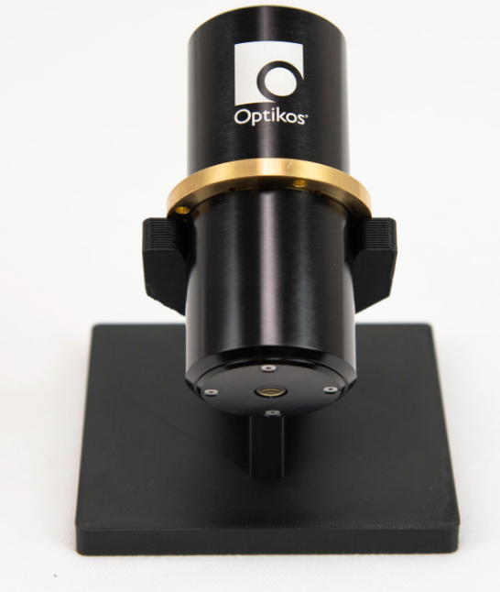
How do I Build an Optical Assembly?
Optics Sourcing
Pros
Cons
Catalog lens assemblies
(Photographic lenses, microscope objectives etc.)
Reasonable cost
Rapid delivery
Convenient precision
Fixed form factor
Fixed optical parameters
Mixed performance
Catalog components (singlets, doublets, mirrors etc.)
Modest cost
Rapid delivery
Flexible assembly options
Limited design performance
Modest fabricated performance
Limited offerings
Designed for purpose
Assembled performance is controlled
Potentially molded optics
Expensive in low volumes
Long lead times
Custom lens assemblies

Slide 11
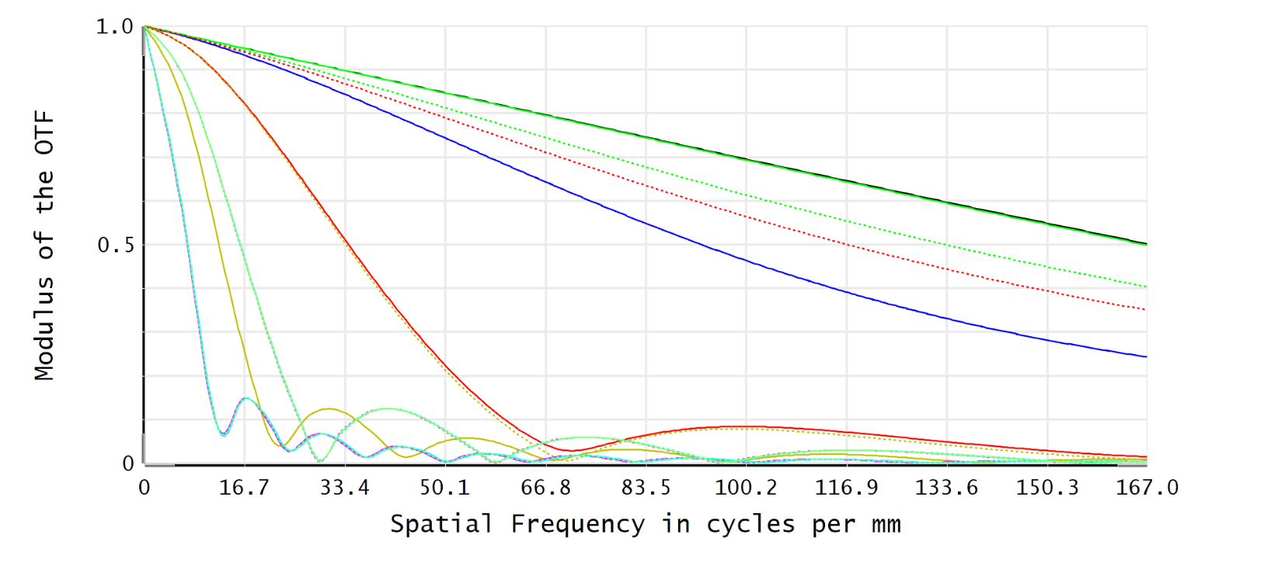
Lens Resolution and MTF (Modulation Transfer Function)
Diffraction limit. The best possible MTF for this NA
MTF (often expressed as a percentage)
Different colored traces represent different locations in the field of view
Nyquist frequency for 5μm pixels

Slide 12
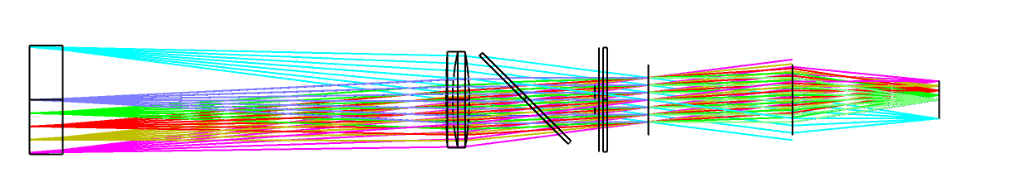
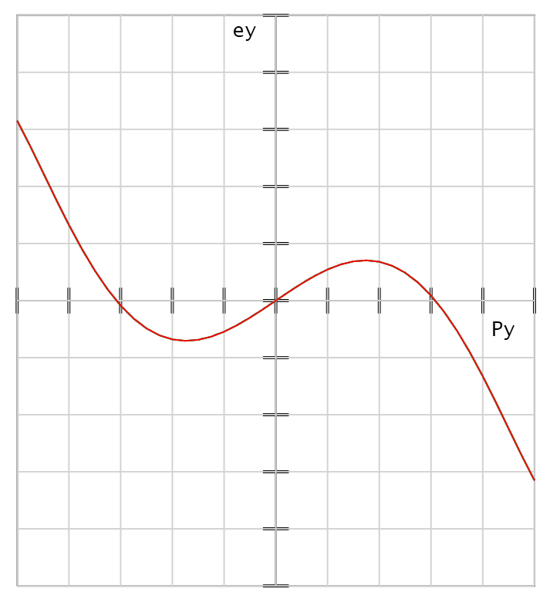
Some Interesting Aspects of the Lumicell Optical Design
Fluorescing Object at window surface
Interference filters exhibit center wavelength shift with angle
Paraxial lens
Aperture Stop
Camera Sensor
Illumination
Beware plano parallel windows in converging beam – spherical aberration!

Slide 13
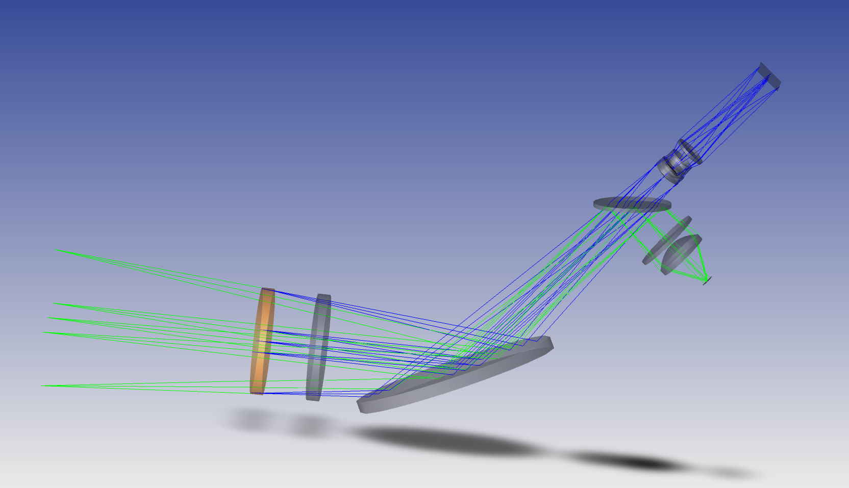
Beam Folding in the Lumicell Optical Design
Understanding the asymmetry of the mirror placement in a reflected converging beam is critical
Optical Axis

Slide 14
Prototyping and Prep for Clinical Trials

Slide 15
Clinical Trial Readiness and Regulatory Path
Transitioning from prototype to a clinically viable system
Intended use to guide resections: Class III device (higher risk)
No predicate device + Class III = PMA regulatory path
Follow Design Controls Process, FDA guidance documents, regulations
Detailed documentation of design history files, user needs, design inputs, design outputs, verification, validations, risk evaluation, clinical trial reports, benefit-risk assessment
Final submission: 11 volumes, several hundreds of thousands of [electronic] pages

Slide 16
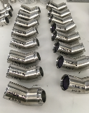
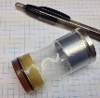
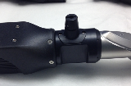
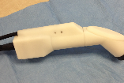
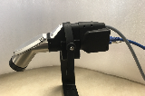
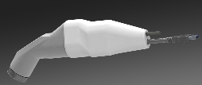
Development Process
2013
2014
2015
2016
2017
2018
2019
2020
Phase A + B (Jun 2015-Oct 2017)
Phase C (Feb 2018–Jun 2019)
Pivotal (Nov 2019-2022)

Slide 17
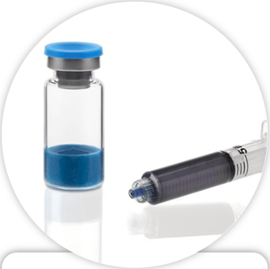
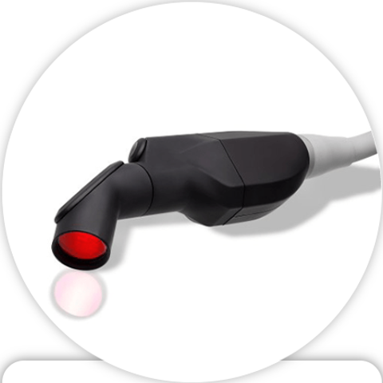
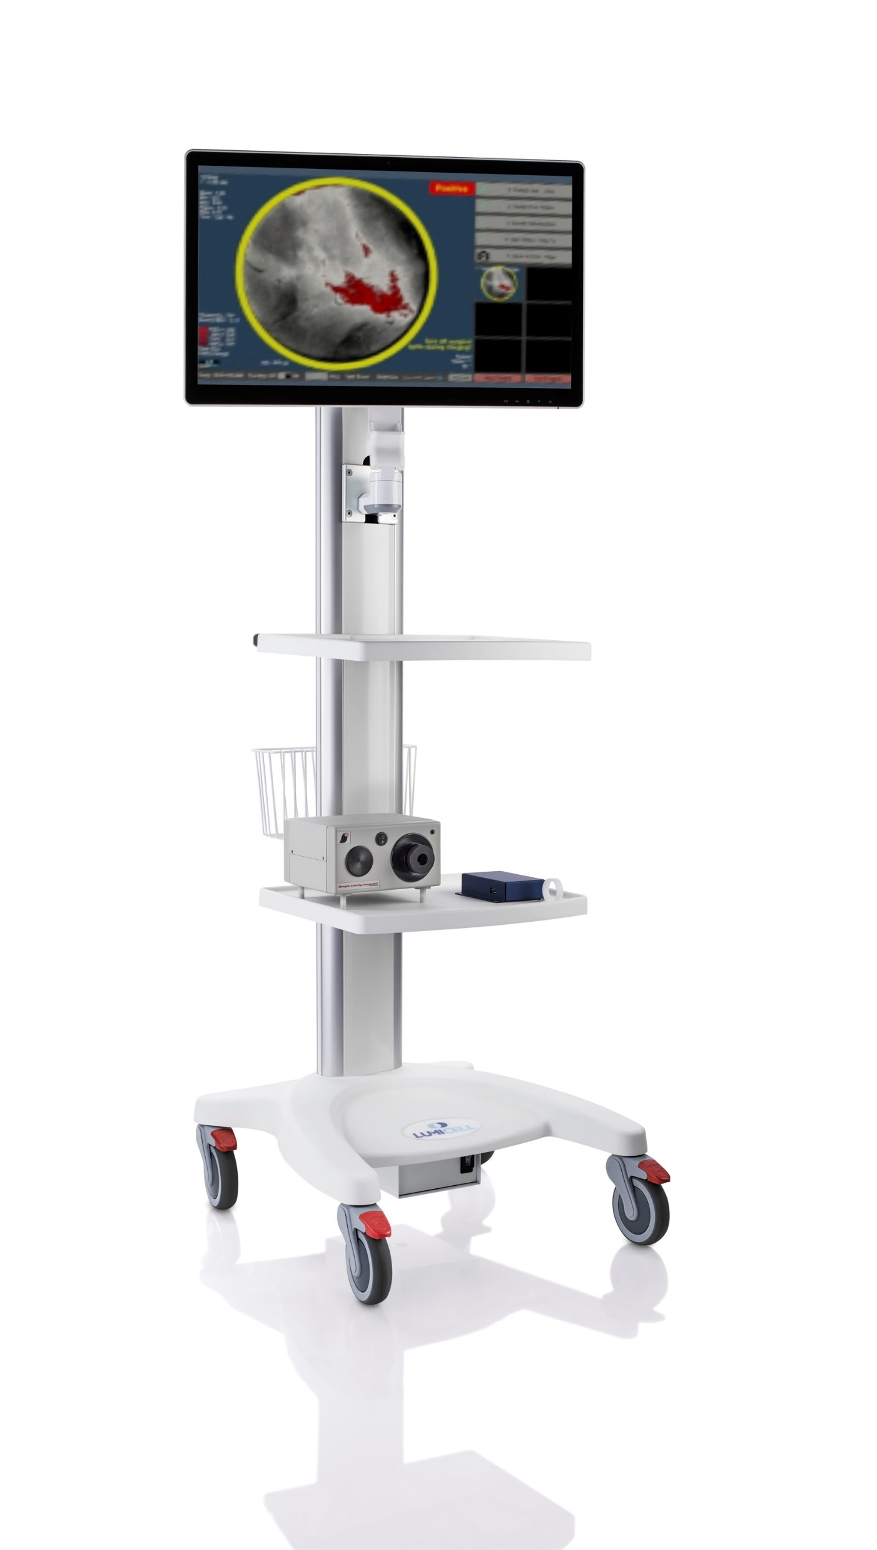
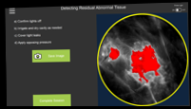
Current State of Product (2025)
Drug and Device FDA-approved since April 17, 2024!
Initial commercial launch – currently in use at 11 hospitals across the US
LUMISIGHT
Lumicell Direct Visualization System (DVS)
+
Find
Detect
Guide
Optical imaging agent that produces fluorescence signal at sites of residual cancer
Hand-held imaging probe inserted into breast cavity to identify residual cancer
Real-time cancer detection software guides surgeon to remove residual cancer

Slide 18
Key Takeaways
Partnering early in the development process was important
Clear division of responsibilities based on capabilities and strengths
Open sharing of information was very helpful
Identifying what most was important in the instrument helped focus the design effort
Thank you!

Slide 19
Q&A

